Slide 1
Server Administrator
By Shadman Ahmed
CIS 121 - Intro to Coding 11:00 AM
Notes:
Hello, my name is Shadman Ahmed and I did research on Server Administrators.

Slide 2

Career Description
Overseer
Security
Maintenance
Recovery
Diagnosis
PHOTO BY: GORODENKOFF | iStock
Notes:
They are the overseer of all servers in the company along with a team of junior IT staff. They also implement server patches to maintain the server to keep up with company data. The server team is also responsible for daily firewall patches to keep company data secure. They help recover lost passwords while keeping the server secure. They deal with any issues in the server by diagnosing and rolling out patches as soon as possible.

Slide 3

Skills Required
Task-oriented
Optimistic
Curious
Analytical
Proactive
PHOTO BY ANDOR BUJDOSO | PHOTODUNE
Notes:
To be a server administrator one must focus on tasks with energy and curiosity to be able to continuously maintain the server. They must analyze all issues and actively fix them one by one. It Is essential to be like this for every single issue that occurs in a company.

Slide 4
Education/Experience
Bachelors in Computer Information Systems.
Scripting
Networks
HTML/CSS/JavaScript
Masters in networks (preferable).
“Server+”/ “MSCE”/ “RHCE” certification preferred.
Notes:
A masters with a 4-year degree is preferred in most positions alongside the certifications listed. Most server administrators will need a background in scripting and networks to understand the behavior of the server and how to change those behaviors. Since employees are using the server in another location, they are doing so through a website therefore web language background is also necessary to implement the changes required.

Slide 5
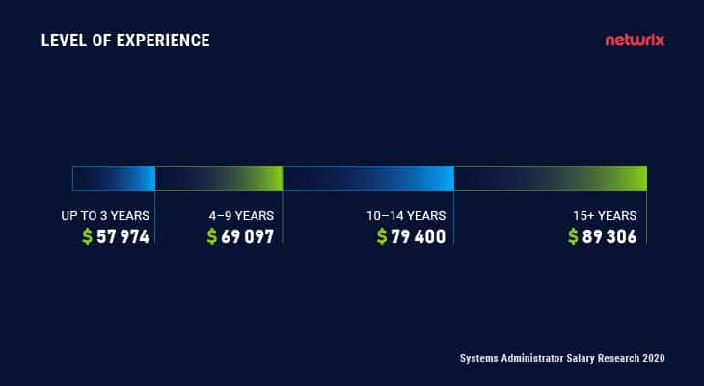
Salary (per year)
Starting: $63,663 per year
Median: $88,330 per year
Notes:
Most server administrators start out with around $60k per year or $30 per hour. As time progresses and more experience is gathered, their salary increases by around 20-40k to an average median salary of 88k.

Slide 6
Job Availability
Jobs are available everywhere.
Every company has server rooms.
All servers need managing.
Position may never be outsourced.
Remote positions are available.
Notes:
Jobs are available anywhere because almost all medium to big companies have servers to maintain their data. Server administrators main those servers so it is almost impossible to outsource this position. Servers are able to be managed remotely too.

Slide 7

Why is this career interesting?
You’re essential for company
Every company needs one
Our website’s on a server
Easier than most CIS Jobs.
Notes:
Once you become a server administrator for a company, you are essentially the main person responsible for ALL (for a small-medium company) or part (of a bigger company with many servers) of the company’s data. The best part is that EVERY company needs one and there are a lots of different companies in this world like hospitals, government servers, schools, etc. Even website that we made is on a server stored under the Twin Rise building (AKA your Z Drive) for which a server administrator is responsible for.

Slide 8
Bibliography
“Entry Level Server Administrator Salary - Zip Recruiter.” Entry-Level Server Administrator Salary, Zip Recruiter, https://www.ziprecruiter.com/Salaries/Entry-Level-Server-Administrator-Salary.
Matzelle, Emily. “Your next Move: Server Administrator.” Server Admministrator, CompTIA, 4 May 2022, https://www.comptia.org/blog/your-next-move-server-administrator.
“Server Administrator Job Description and Salary.” FieldEngineer, https://www.fieldengineer.com/skills/server-administrator#:~:text=To%20become%20a%20Server%20Administrator,with%20databases%20and%20WANs%2FLANs.
“What Does a Server Administrator Do?” Western Governors University, 7 May 2021, https://www.wgu.edu/career-guide/information-technology/server-administrator-career.html#close.
“Windows Server Administrator .” Windows Server Administrator Salary, Indeed, https://www.indeed.com/career/windows-server-administrator/salaries.
Brooks, Ryan, and Ryan Brooks Product Evangelist at Netwrix Corporation. “System Administrator Salary: How Much Can You Earn?” Netwrix Blog, https://blog.netwrix.com/2020/07/09/systems-administrator-salary/.

